Slide 1


ET3_Cash
Full-Stack Web and Mobile Application

Slide 2
TABLE OF CONTENTS
01
02
03
Project Overview
Significance
Purpose and Objectives

Slide 3
TABLE OF CONTENTS
04
05
06
Features
Data workflow
Technology Stack

Slide 4
TABLE OF CONTENTS
07
08
09
System Architecture
Setup and Installation
Screenshots or Demos

Slide 5
TABLE OF CONTENTS
10
11
12
Future Enhancements
Conclusion
Challenges and Solutions

Slide 6
Project Overview
The ET3_Cash application is a comprehensive full-stack solution designed to simplify and enhance financial management for users across web and mobile platforms. Combining powerful backend capabilities, interactive frontend designs, and seamless mobile experiences, the application addresses the growing demand for secure, accessible, and feature-rich financial tools.

Slide 7
Purpose and Objectives
Purpose
Objectives
To empower users with a user-friendly platform for managing financial transactions and accessing advanced analytics.
Provide a scalable, secure, and efficient solution for financial operations. Ensure seamless user experience across devices.

Slide 8
Significance
Solves the challenges of fragmented financial tools by integrating all essential features (e.g., deposit, withdrawal, payments) into one application.
Enhances decision-making through advanced analytics and intuitive dashboards, making financial operations smarter and more efficient.
Reduces the complexity of financial management for users while providing real-time data visualization and insights.

Slide 9
Features
🛠️
🚀
📱
DevOps
Streamlined CI/CD pipelines and Docker ensure smooth deployments, efficient workflows, and reliable application maintenance.
Backend “RESTful APIs powered by Django for secure and efficient server-side operations.
Mobile App Flutter ensures seamless cross-platform mobile experiences on both iOS and Android.
🎨
📊
✅
Frontend
Built with Vue.js, combined with HTML, CSS, JavaScript, and TypeScript, to deliver dynamic and user-friendly web interfaces.
Dashboard Interactive and visually appealing dashboards utilizing Chart.js for real-time data representation.
Automated Testing
Comprehensive testing frameworks to maintain code quality, reliability, and bug-free performance.

Slide 10
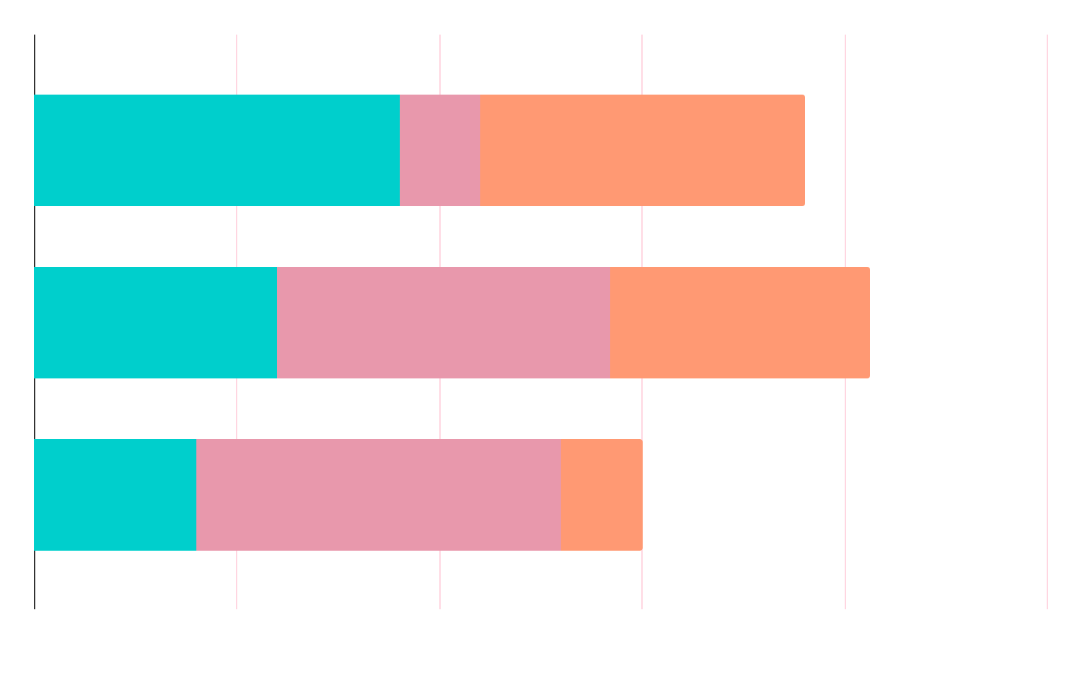
Data workflow
📈
Data Science
Advanced analytics and ML / DL models & Big data integrated for predictive insights and intelligent decision-making support.
📊
Data Warehouse
Centralized aggregated data storage enabling comprehensive analytics, reporting, and business intelligence insights.
🗄️
Database PostgreSQL offers reliable, scalable, and secure data management and storage solutions.

Slide 11
Technology Stack Overview
Component | Technology
🔙 Backend | Django (RESTful APIs), Python
🎨 Frontend | Vue.js, HTML, CSS, JavaScript, TypeScript
📱 Mobile App | Flutter (Cross-platform for iOS & Android), Dart
📊 Dashboard | Chart.js, JavaScript, HTML, CSS
📈 Data Science | Python, Machine Learning (ML), Deep Learning (DL), Scikit-learn, TensorFlow, Keras, NumPy, Pandas, Matplotlib
🗄️ Database | PostgreSQL, SQL, Data Warehousing
📊 Data Warehouse | Data Aggregation, Business Intelligence (BI) Tools, ETL Processes
🚀 DevOps | CI/CD Pipelines, Docker, Jenkins, Kubernetes, AWS, Azure
✅ Automated Testing | Cypress, Jest, Selenium, PyTest, Unit Testing, Integration Testing

Slide 12
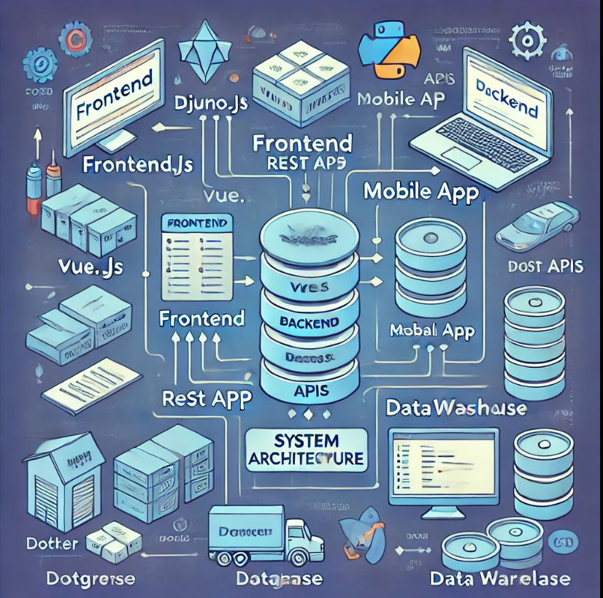
System Architecture Overview
Diagram Description:
Frontend:
Web Interface (Vue.js, HTML, CSS, JavaScript, TypeScript)
Communicates with the Backend through RESTful APIs.
Backend:
Django (RESTful APIs powered by Django)
Handles all business logic and data processing.
Interacts with the Database and Mobile App.
Mobile App:
Flutter (iOS & Android)
Consumes the same RESTful APIs as the Web Interface, ensuring consistency across platforms.
Syncs with the Backend for real-time data updates.

Slide 13
System Architecture Overview
Diagram Description:
Database:
PostgreSQL for structured data storage.
Interacts with the Backend for data retrieval, updates, and transactions.
Data Warehouse:
Aggregates data from multiple sources, enabling advanced Data Analytics and Business Intelligence.
DevOps:
CI/CD Pipelines, Docker for continuous integration and deployment.
Ensure smooth application updates and scalability.

Slide 14
Analytics & Data Science
Key Tools & Techniques: 1-Python: The core language used for data processing, machine learning, and deep learning.
2-Machine Learning (ML): Algorithms like Decision Trees, Random Forest, Support Vector Machines (SVM), etc., are used to make predictions based on historical data.
3-Deep Learning (DL): Utilizes neural networks (e.g., CNNs, RNNs) for more complex data tasks, such as image recognition and NLP.
4-Scikit-learn: A key library for ML algorithms, including classification, regression, and clustering techniques.
5-TensorFlow & Keras: Used for building deep learning models, including neural networks for more advanced predictive analytics.
6-Pandas: For data manipulation and cleaning.
7-NumPy: Used for numerical operations and matrix computations.
8-Matplotlib & Seaborn: Visualization libraries for generating graphs and charts to represent data insights.

Slide 15
Key Analytics & Techniques
Active Users
AGE
1-Predictive Modeling: Leveraging historical data to forecast future trends and behavior patterns.
2-Data Visualization: Using libraries like Chart.js, Matplotlib, and Seaborn for visual representation of data insights.
3-Big Data Analytics: Leveraging large datasets for deeper insights and business intelligence
20-39
80%
40-60
50%
75%
Active
500,000+
Customers
25%
inActive

Slide 16
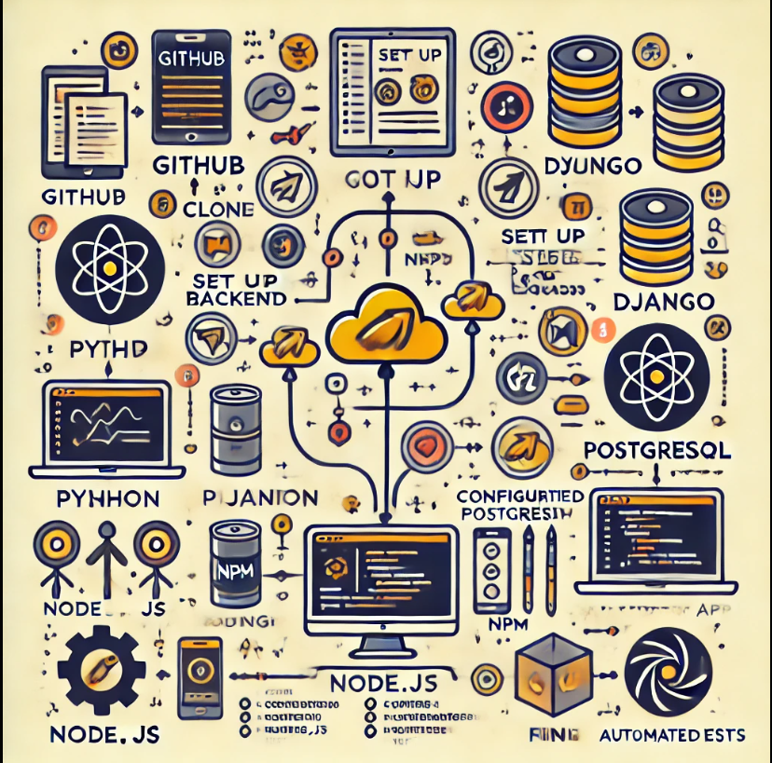
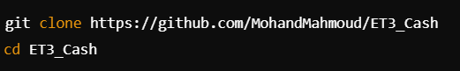
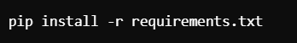
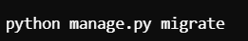
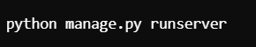
Setup and Installation
Installation Steps
Clone the Repository: GitHub Repository:
ET3_Cash GitHub Repository

Slide 17
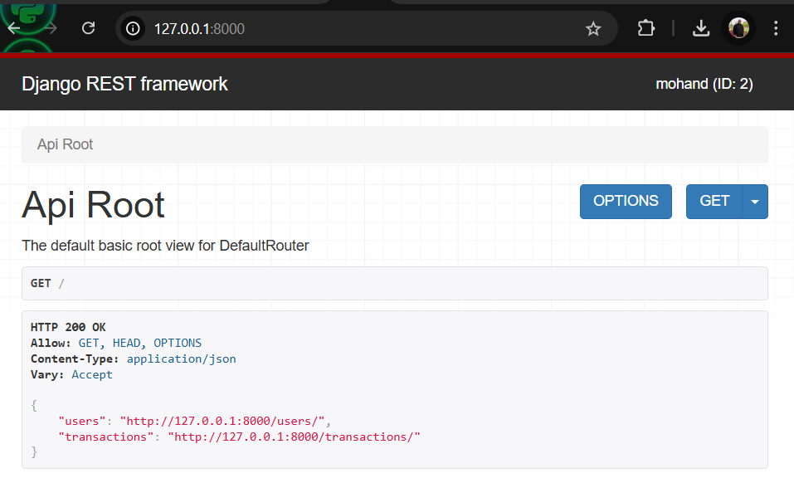
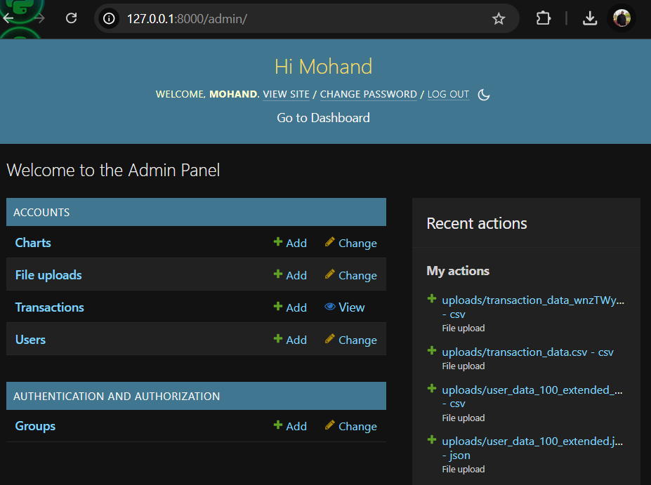
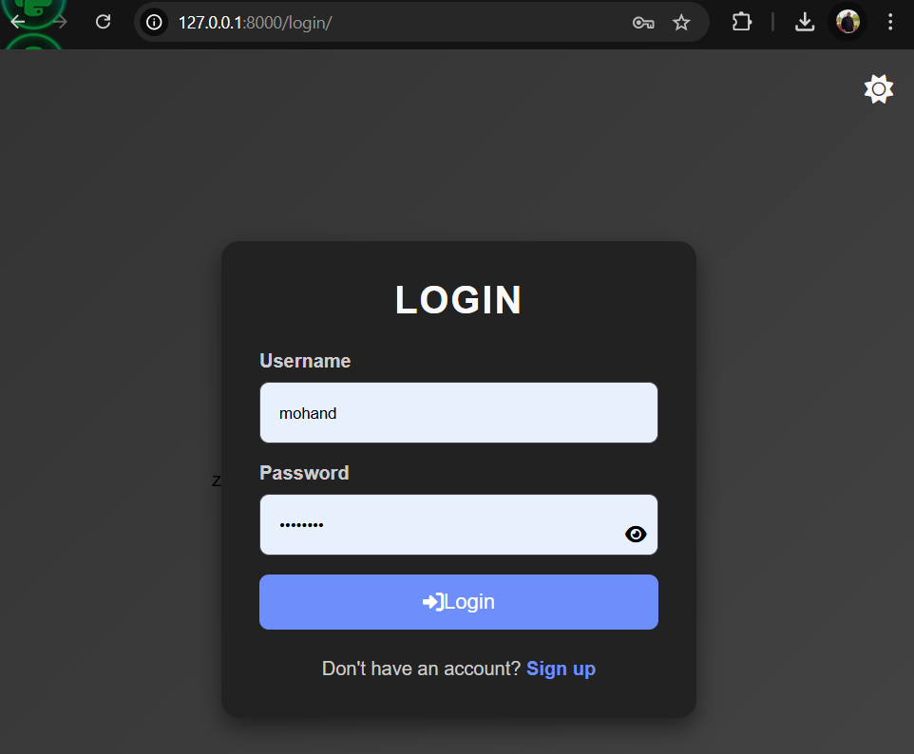
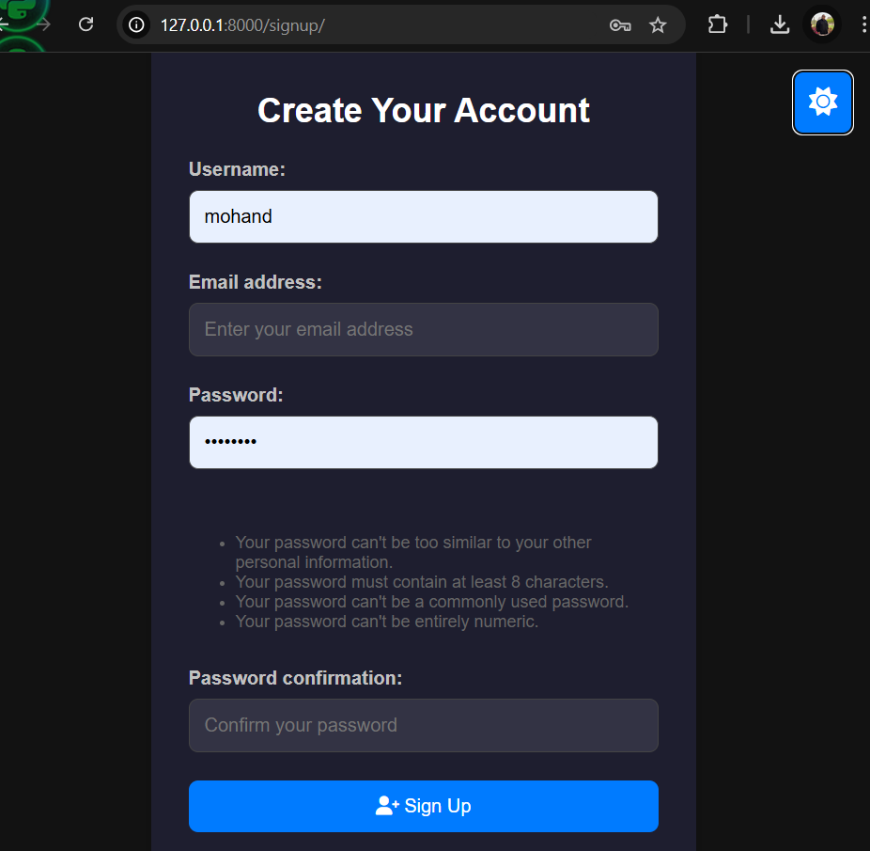
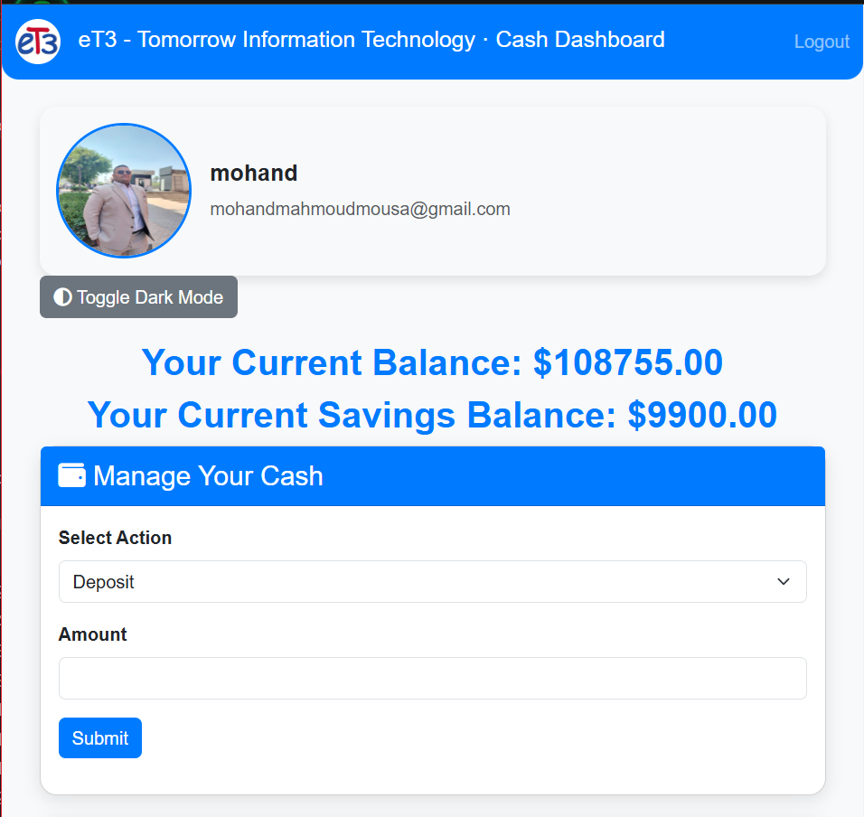
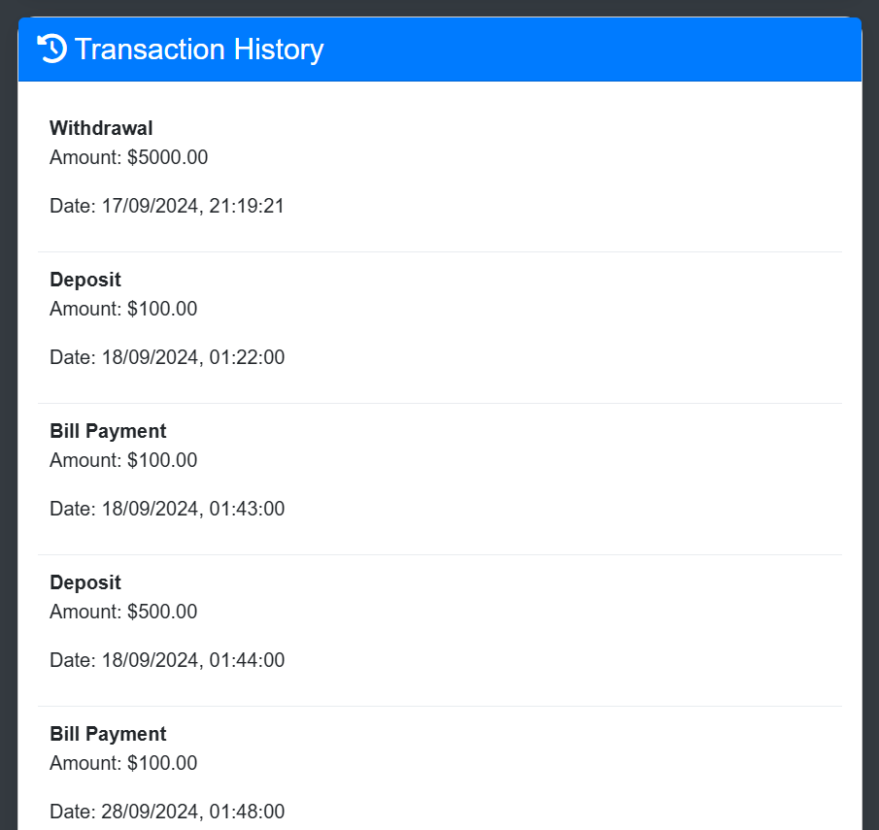
Screenshots or Demos
Web Interface Screenshots

Slide 18
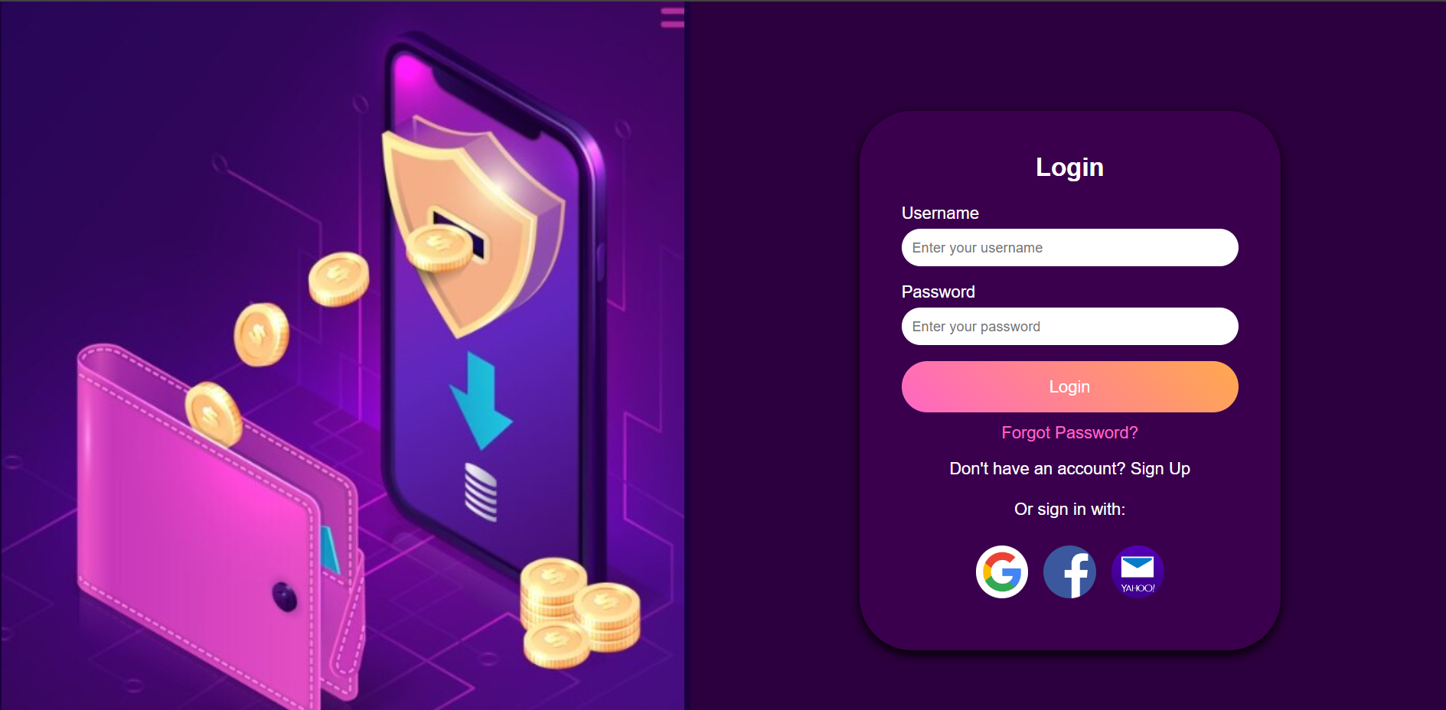
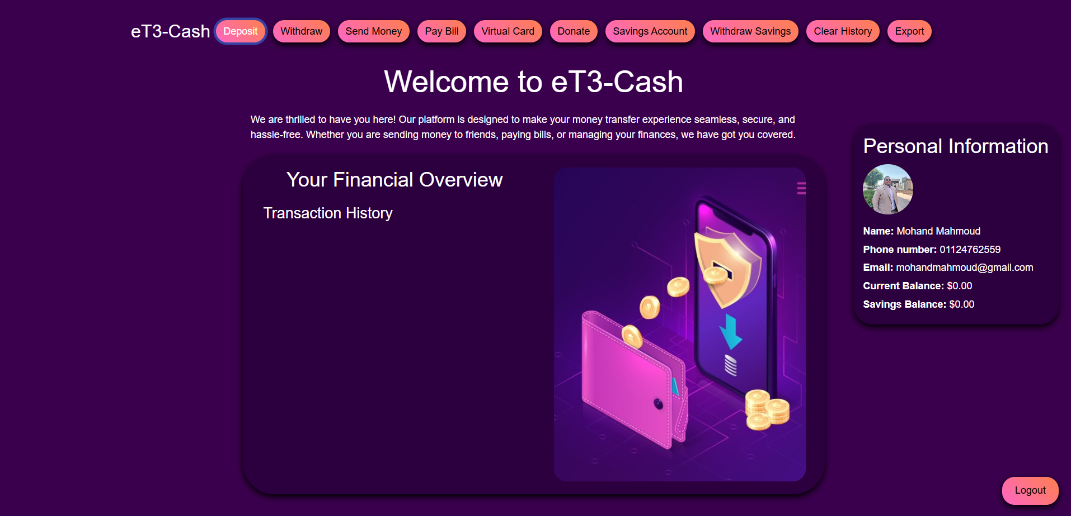
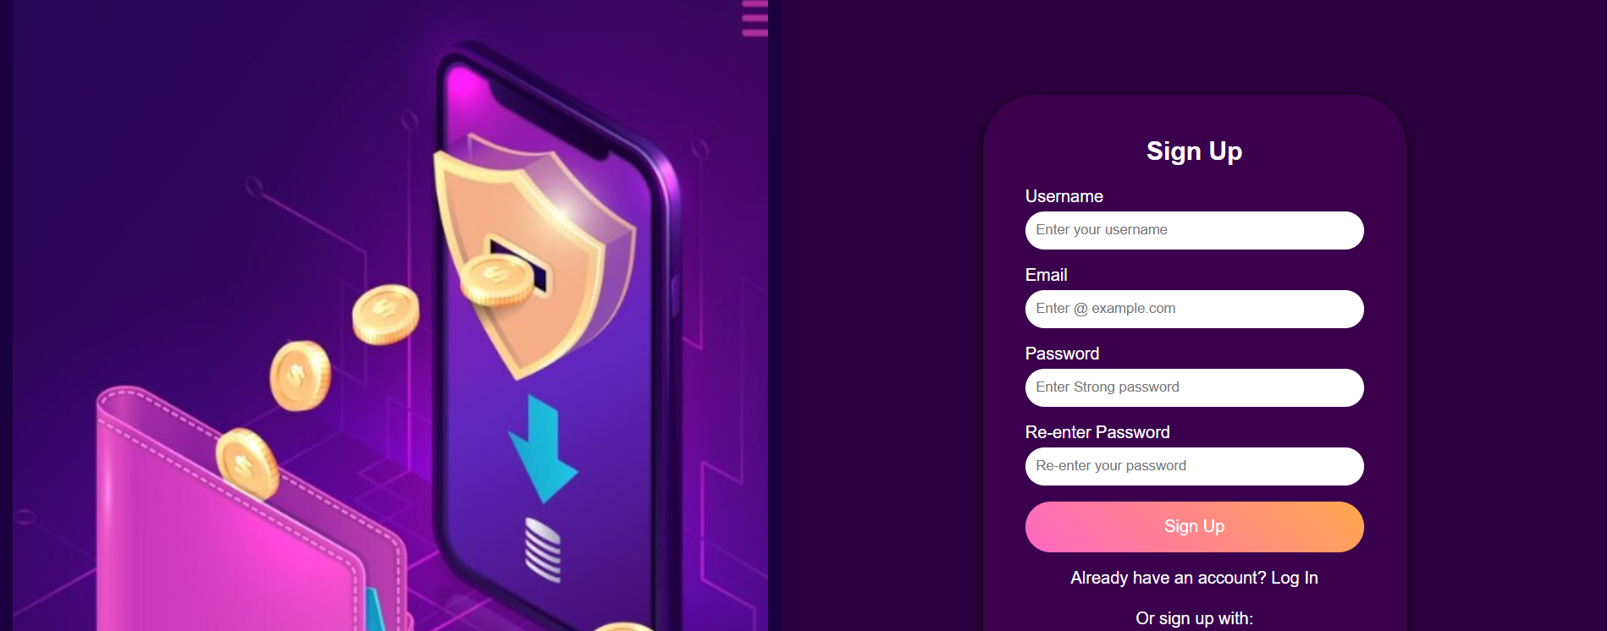
Screenshots or Demos
Web Interface Screenshots DevOps &Vue.js

Slide 19
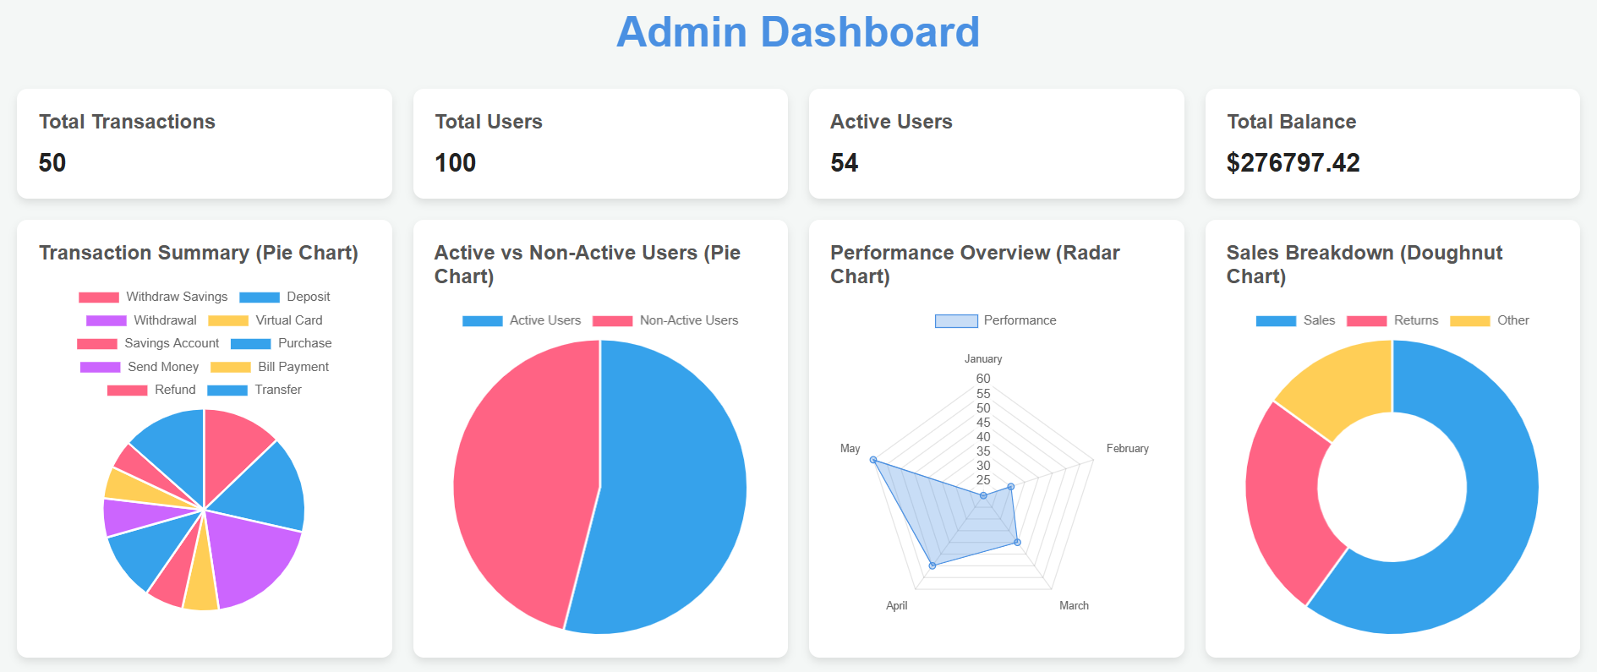
Screenshots or Demos
Dashboard

Slide 20
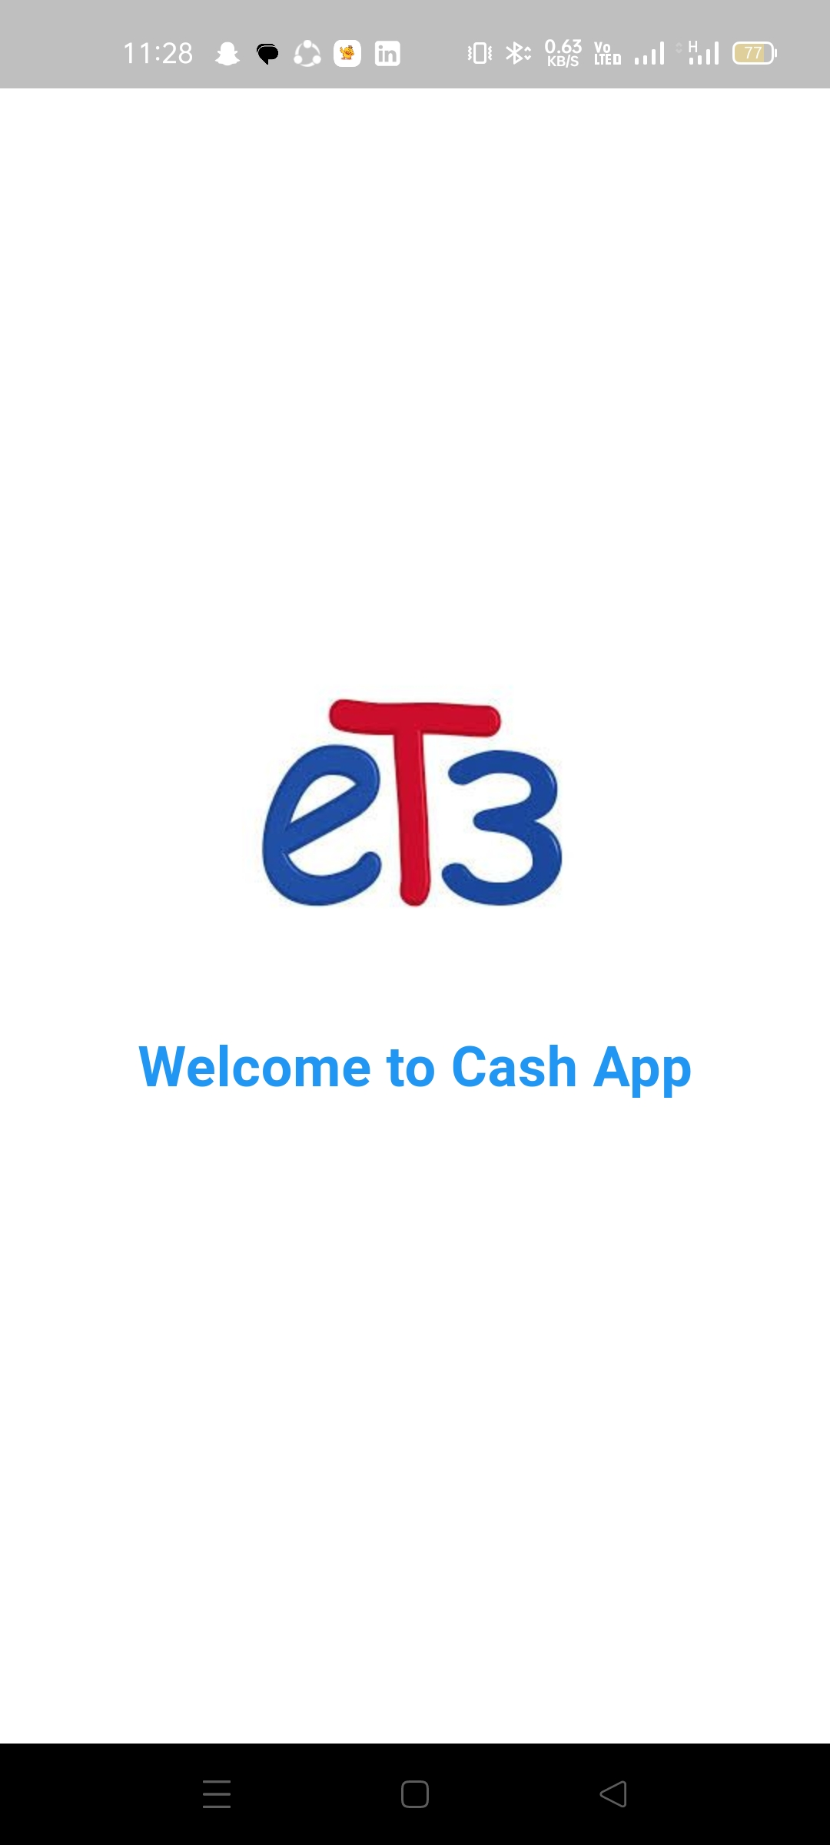
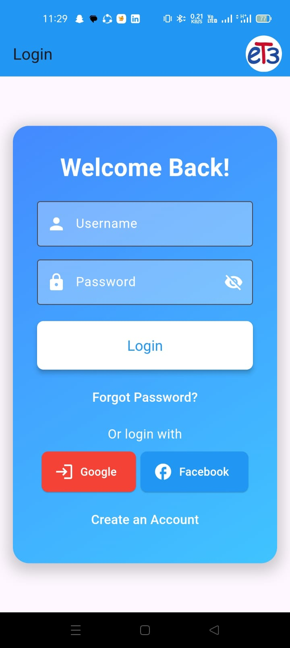
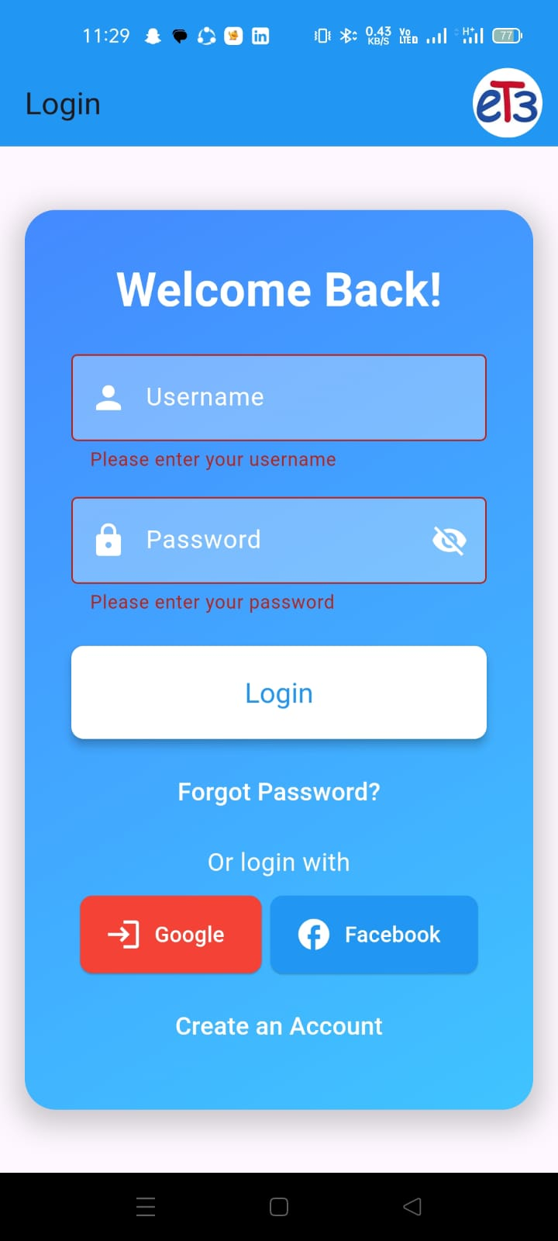
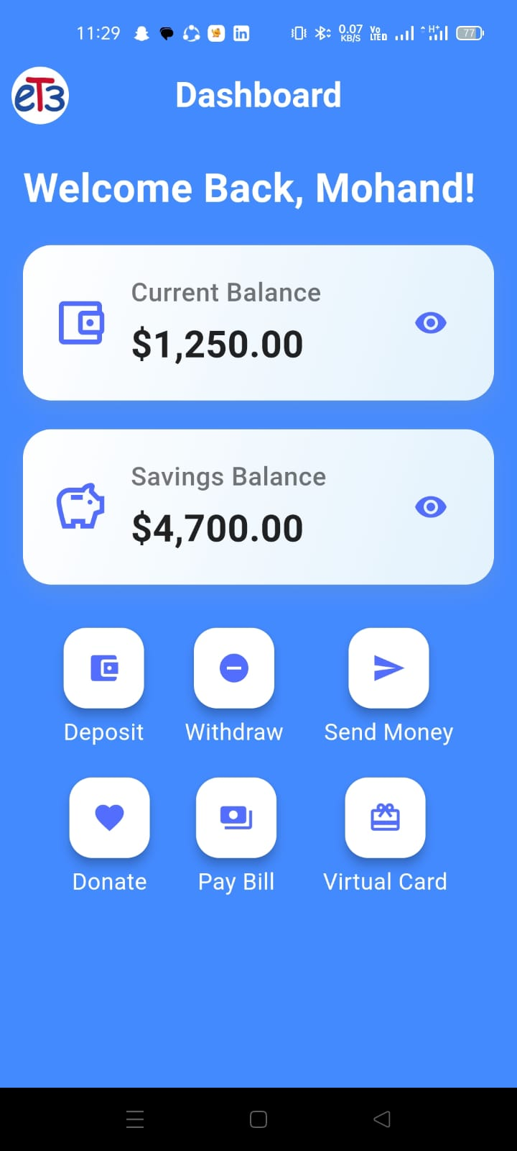
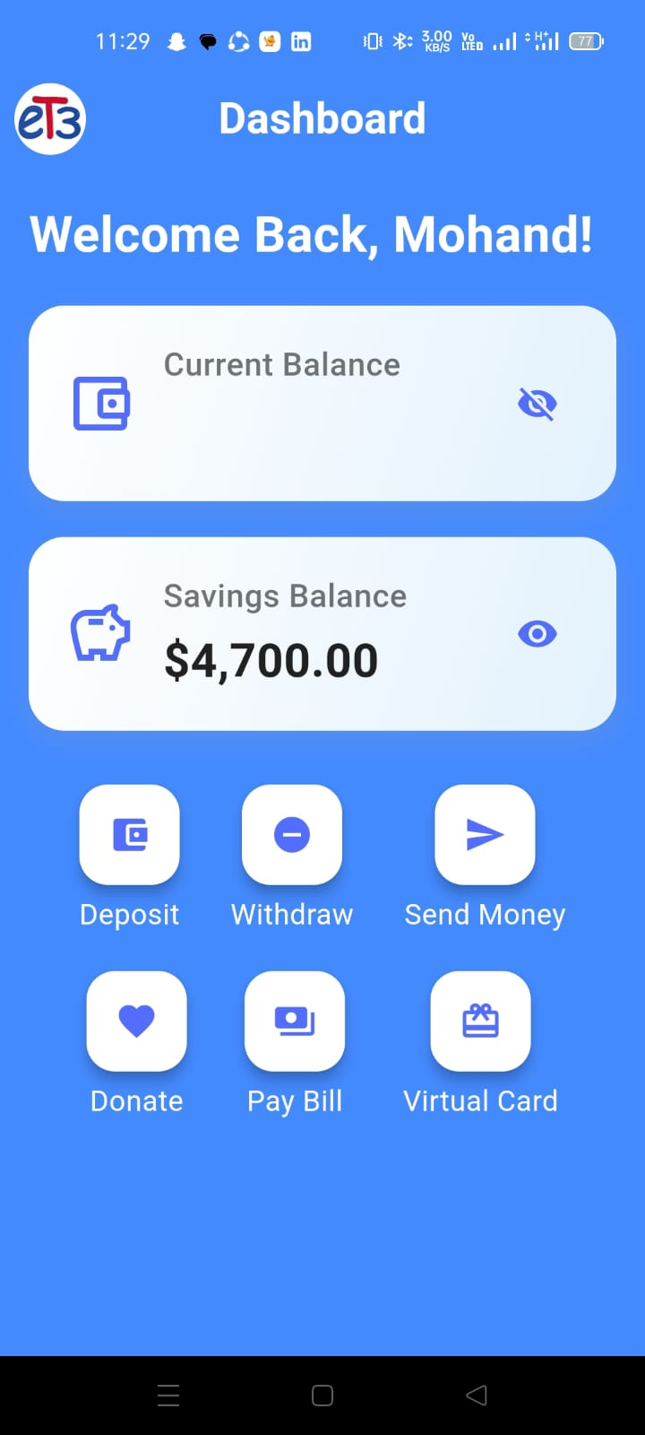
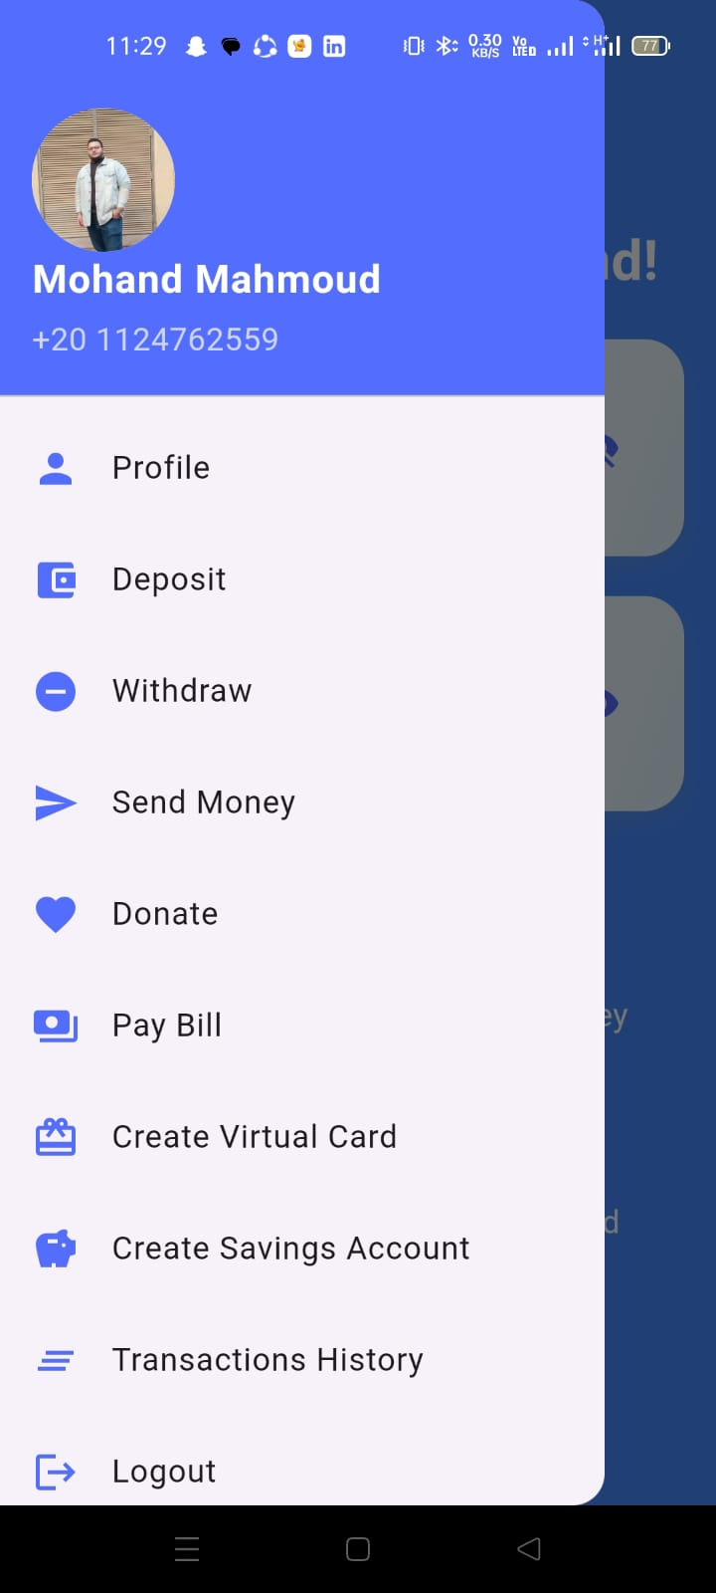
Screenshots or Demos
Mobile APP Screenshots

Slide 21
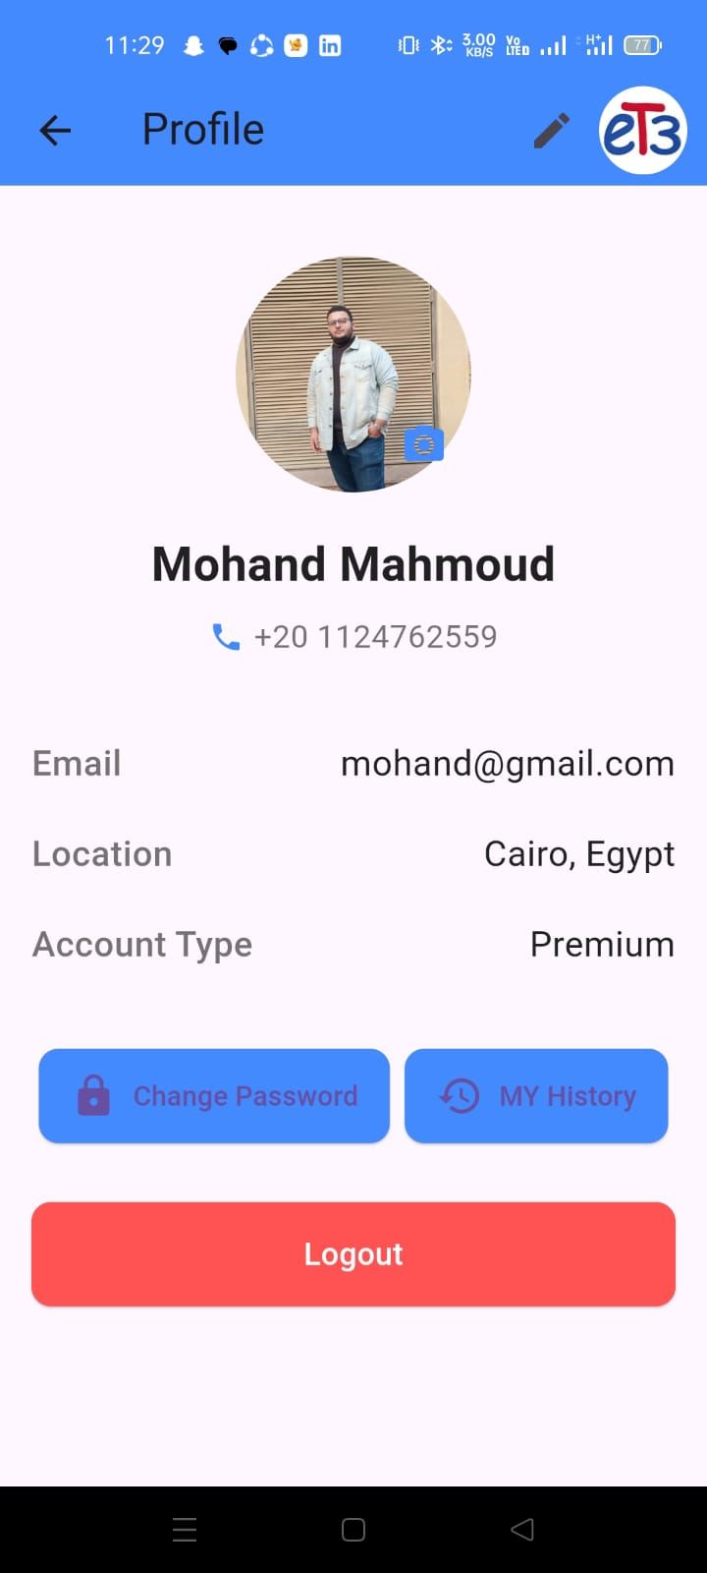
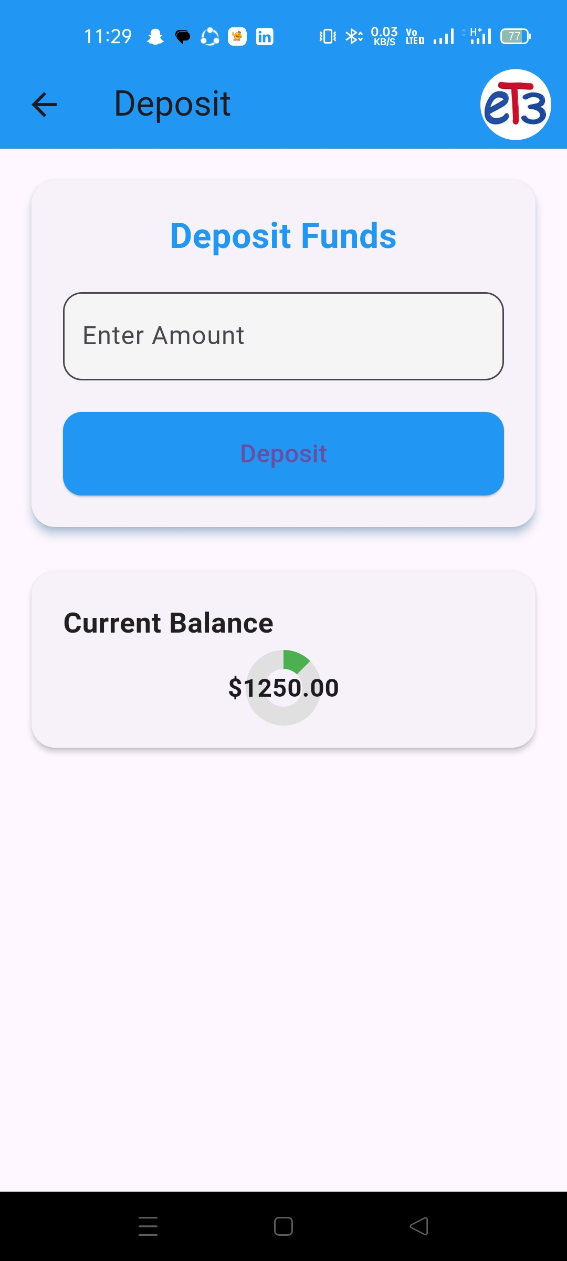
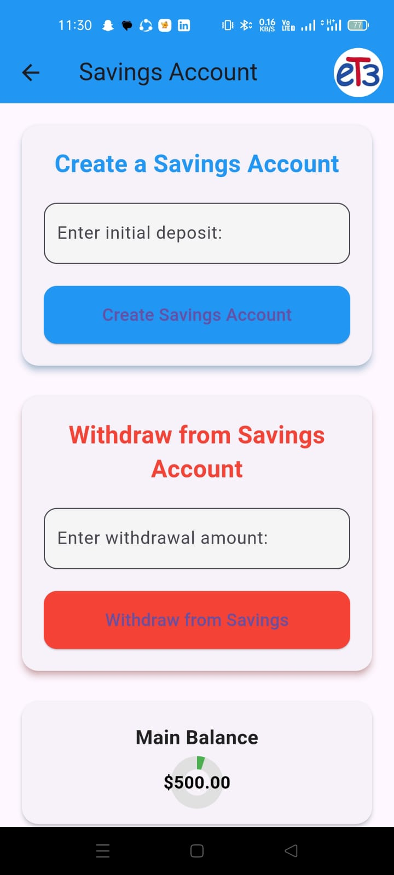
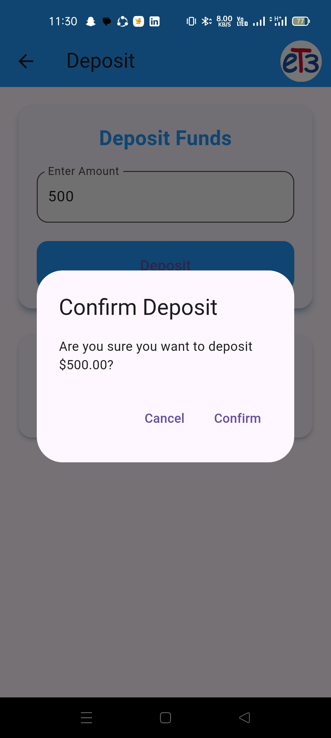
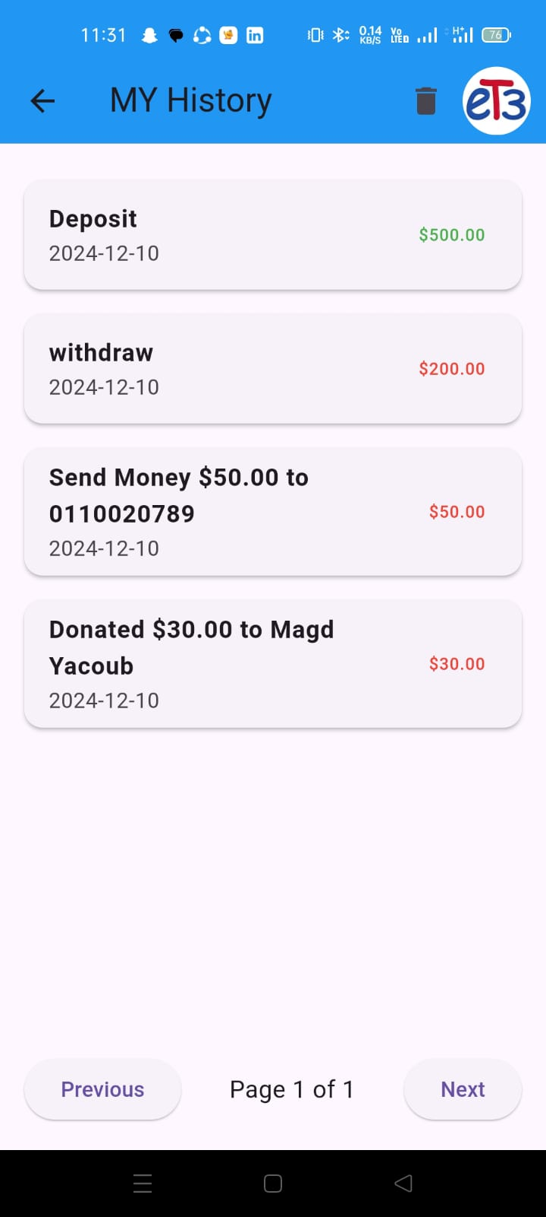
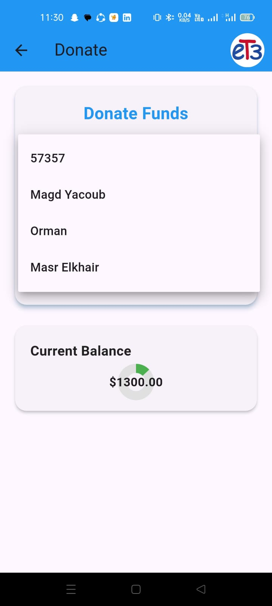
Screenshots or Demos
Mobile APP Screenshots

Slide 22
Challenges
Challenges Faced:
Backend Scalability: Handling high traffic and ensuring server performance.
Cross-Platform Mobile Development: Maintaining consistent functionality across iOS and Android devices.
Database Optimization: Managing large datasets and ensuring fast query performance.
Interactive Dashboard Complexity: Creating dynamic and responsive visualizations for real-time data.
Integrating Machine Learning Models: Seamlessly embedding predictive analytics into the system.
DevOps and CI/CD Pipelines: Automating the deployment process while avoiding downtime.

Slide 23
Solutions
Solutions Implemented:
Backend Scalability: Utilized Django’s efficient request handling and deployed load balancers to distribute traffic.
Cross-Platform Mobile Development: Leveraged Flutter’s single codebase approach to ensure uniform performance on both platforms.
Database Optimization: Optimized PostgreSQL queries and used indexing for faster data retrieval.
Interactive Dashboard Complexity: Integrated Chart.js and customized it to ensure responsiveness and clarity in data representation.
Integrating Machine Learning Models: Deployed trained models as APIs using Django REST Framework for easy integration.
DevOps and CI/CD Pipelines: Configured Jenkins and Docker for automated builds, testing, and deployments.

Slide 24
Future Enhancements
Planned Improvements:
Enhanced Security Features:
Implement two-factor authentication (2FA).
Advanced encryption for sensitive user data.
AI-Powered Features:
Integrate advanced machine learning models for fraud detection.
Personalized recommendations based on user behavior.
Expanded Analytics:
Add more comprehensive business intelligence tools.
Enable real-time predictive analytics dashboards.
Mobile App Enhancements:
Push notifications for transaction updates and reminders.
Add biometric authentication (fingerprint and face ID).

Slide 25
Future Enhancements
Planned Improvements:
Global Accessibility:
Multi-language support for web and mobile interfaces.
Regional payment gateways for a wider user base.
Improved User Experience:
Dark mode for both mobile and web platforms.
Customizable dashboard layout.
Additional Features:
Introduce a rewards and loyalty program.
Expand API integrations with third-party tools like Zapier.

Slide 26
Conclusion
Key Takeaways:
Delivered a feature-rich, scalable, and high-performance application integrating web, mobile, and analytics capabilities.
Leveraged modern technologies like Django, Flutter, Vue.js, and PostgreSQL to create a secure and user-friendly experience.
Focused on solving real-world challenges through advanced machine learning and predictive insights.
Built a foundation for future growth with planned enhancements and innovative features.
30%
80%
50%

Slide 27
THANKS
Do you have any questions?
mohand.mahmoud@gmail.com 01124762559
https://et3egypt.com

